Slide 1
Spread Trading in Fixed Income Market
Name: Xinyao Jie
NYU-ID: Xj537
Professor: Daniel H Totouom Tangho

Slide 2
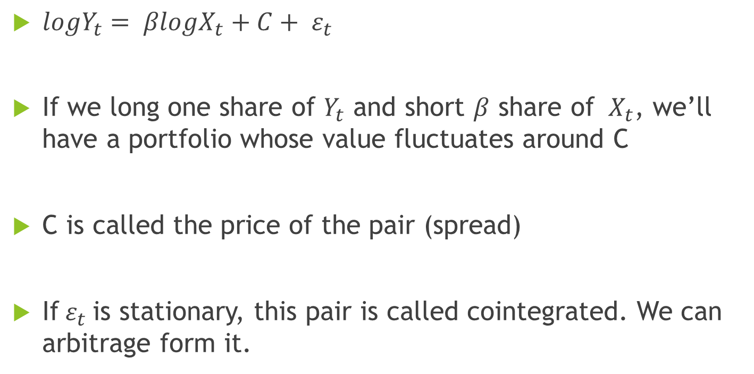
Brief Introduction to Pair Trading
${logY}_{t}= βlogX_{t}+C+ ε_{t}$
If we long one share of $Y_{t}$ and short $β$ share of ${ X}_{t}$, we’ll have a portfolio whose value fluctuates around C
C is called the price of the pair (spread)
If${ ε}_{t}$is stationary, this pair is called cointegrated. We can arbitrage form it.

Slide 3
Pair Trading System Design
Instruments Universe and Data Source
Pair Screen
Trading Rules Design
Out of Sample Test

Slide 4
Instruments Universe and Data Source
3-month Eurodollar Contract:
ED1, ED2, ED3, ……, ED19, ED20
US Treasury Bond: TU(2-year), FV(5-year), TY(10-year), US(30-year), UL(Ultra)
Canadian Bond: CGZ(2-year), CGF(5-year), CGB(10-year)
Collect data from 2013 till now from Quandl
Train–Test Split:
Training: 2013 – 2017
Testing: 2018 - now

Slide 5
Pair Trading System Design
Instruments Universe and Data Source
Pair Screen
Trading Rules Design
Out of Sample Test

Slide 6
Pair Screen
Correlation > 0.9
Unit Root Test P-Value < 0.05 ( cointegrated in 95% significance level)
Using log price regression
|Beta|<3 and vol > 0.001:
When beta is very high, mean of spread goes very high compared to the price of each leg. The cointegration is likely to be overfitting.
Volatility needs to be high enough to make profit. The problem here is these pairs cointegrates too well so that the residuals volatility is very low.

Slide 7
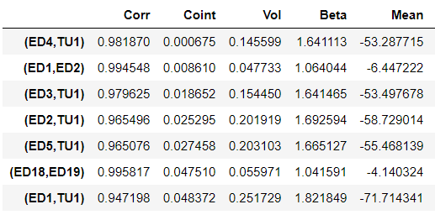
Pair Screen
Selected 7 Pairs:

Slide 8
Pair Trading System Design
Instruments Universe and Data Source
Pair Screen
Trading Rules Design
Out of Sample Test

Slide 9
Trading Rules Design
How should we allocate capital among selected pairs?
When should we open a position?
When should we close a position?
When should we cut a position?
How do transaction costs influence our result?

Slide 10
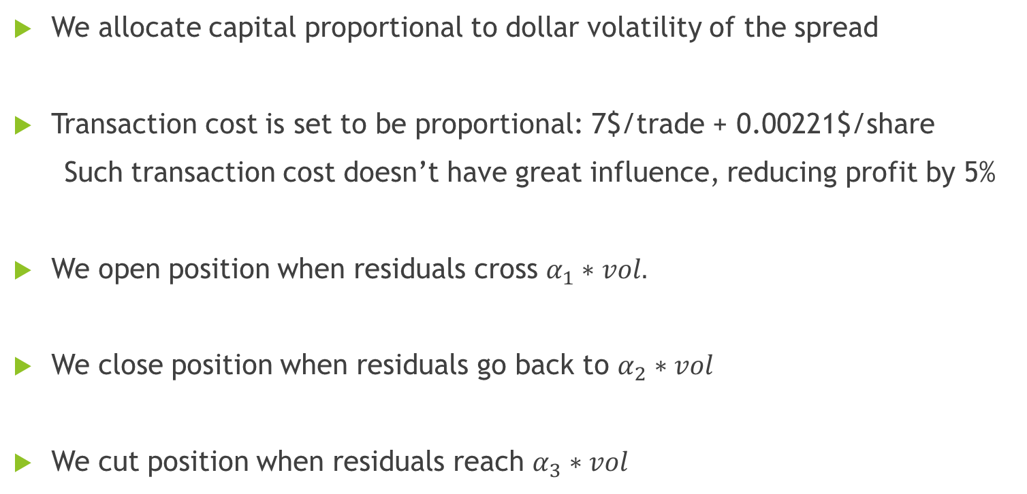
Trading Rules Design
We allocate capital proportional to dollar volatility of the spread
Transaction cost is set to be proportional: 7$/trade + 0.00221$/share
Such transaction cost doesn’t have great influence, reducing profit by 5%
We open position when residuals cross $α_{1}∗vol.$
We close position when residuals go back to $α_{2}∗vol$
We cut position when residuals reach $α_{3}∗vol$

Slide 11
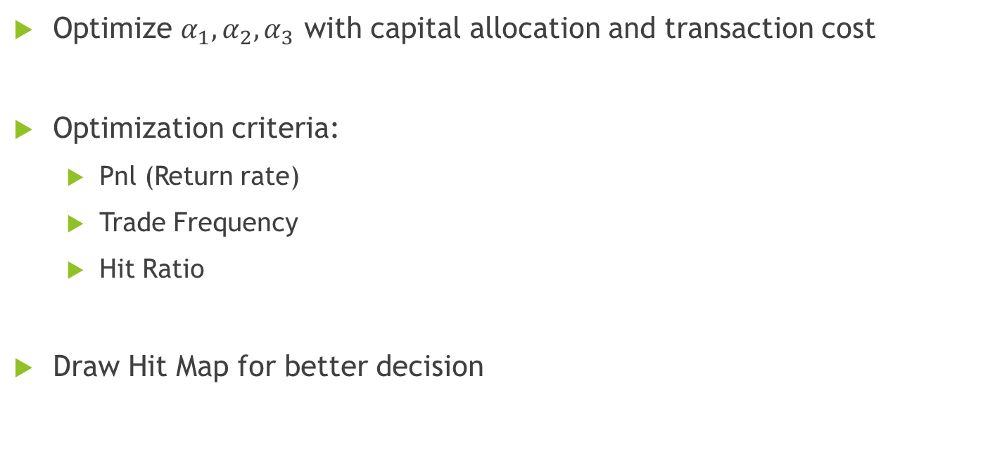
Trading Rules Design
Optimize $α_{1},α_{2},α_{3}$ with capital allocation and transaction cost
Optimization criteria:
Pnl (Return rate)
Trade Frequency
Hit Ratio
Draw Hit Map for better decision

Slide 12
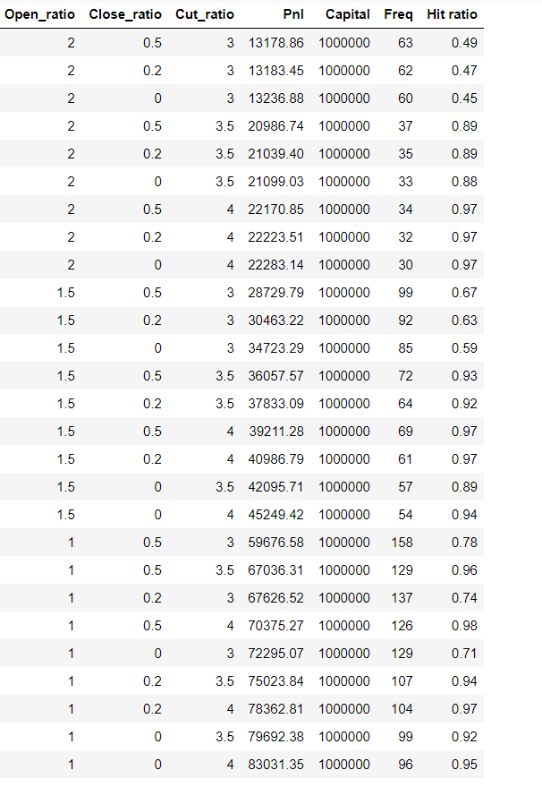
Trading Rules Design

Slide 13
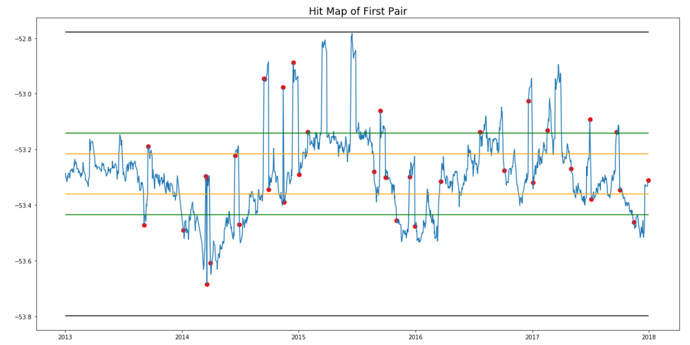
Trading Rules Design
Hit Map for (ED4, TU) as an example

Slide 14
Pair Trading System Design
Instruments Universe and Data Source
Pair Screen
Trading Rules Design
Out of Sample Test

Slide 15
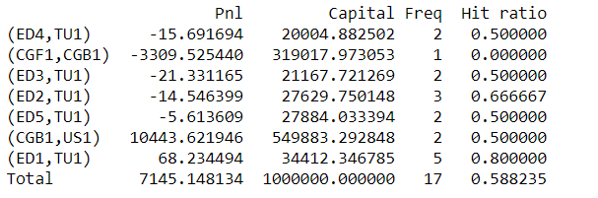
Out of Sample Test
Result of out of sample test:

Slide 16
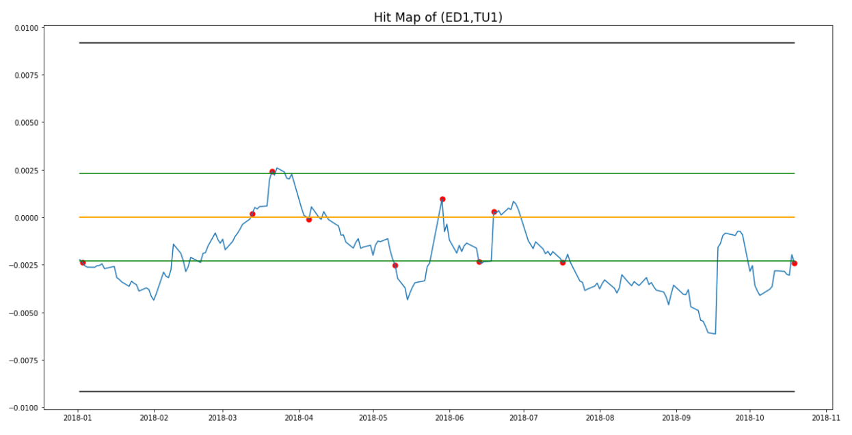
Out of Sample Test
Example of a better pair:

Slide 17
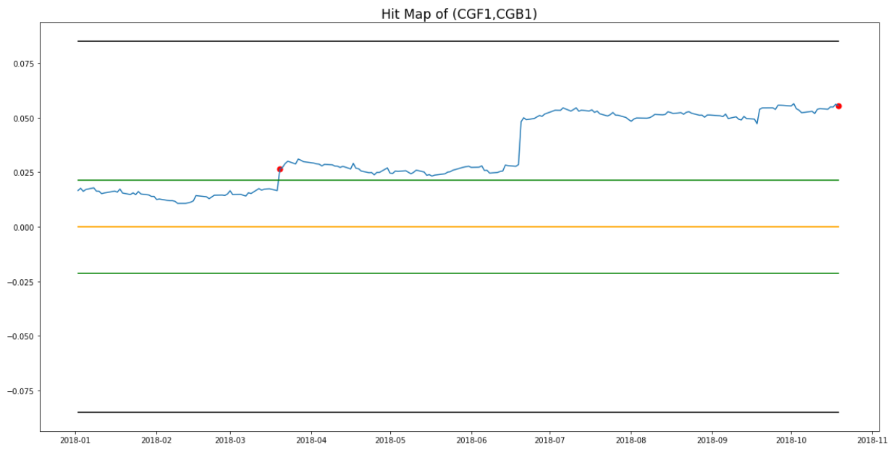
Out of Sample Test
Example of a worse pair: cointegration failure out of sample

Slide 18
Possible Improvements in Future
A bigger universe: select pairs from more instruments
High-frequency data:
Annualized return in daily data is too low, as only a few trades happen in a year
Influence of transaction cost is more significant in high-frequency trading
Cointegration will be more consistent
Rolling basis

Slide 19
Thank you!

